Slide 1
Twitter Storm Instructions!

Slide 2
Instructions
Follow @icp_initiative (we’ll follow you back :) )
Use #SaveTheSafetyNet
Use sample tweets or come up with your own!
Tag people to target
Tag people who support us
Schedule your tweets for 12PM on Friday, March 26
Retweet!
Recruit your friends!

Slide 3
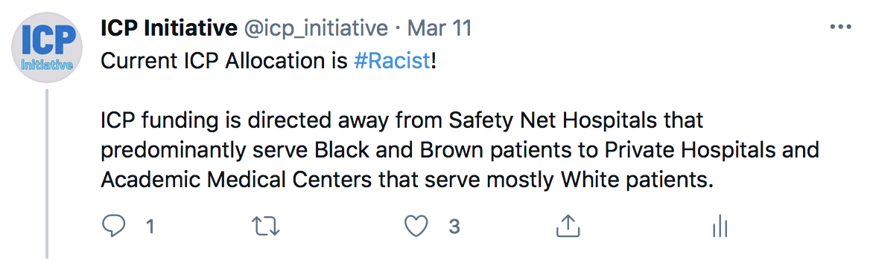
Sample Tweets
Public hospitals provide more than half of the city’s uninsured patients - so why are they getting less than 15% of charity care funding? #SaveTheSafetyNet
Only @NYGovCuomo would cut hundreds of millions of dollars from Medicaid and safety net hospitals in the middle of the pandemic. #SaveTheSafetyNet
Notes:
https://docs.google.com/document/d/1rI0QGVs8duX97lD6MnT4ez0itgCtyTlBlbnpA3KUE8I/edit?usp=sharing

Slide 4
Tag Targets
NYS Legislators
@NYGovCuomo
@AndreaSCousins
@CarlHeastie
NYC Mayoral Candidates
@NYCComptroller
@ericadamsfornyc
@mayawiley
@shaundonovanNYC
@KGforNYC
@RayForMayor
@LoreeSuttonNYC
@cmenchaca
@Dianne4NYC
@AndrewYang
@msbarbarak
@MateotheMayor
@sara4mayor
Notes:
@NYCComptroller
@ericadamsfornyc
@mayawiley
@shaundonovanNYC
@KGforNYC
@RayForMayor
@LoreeSuttonNYC

Slide 5
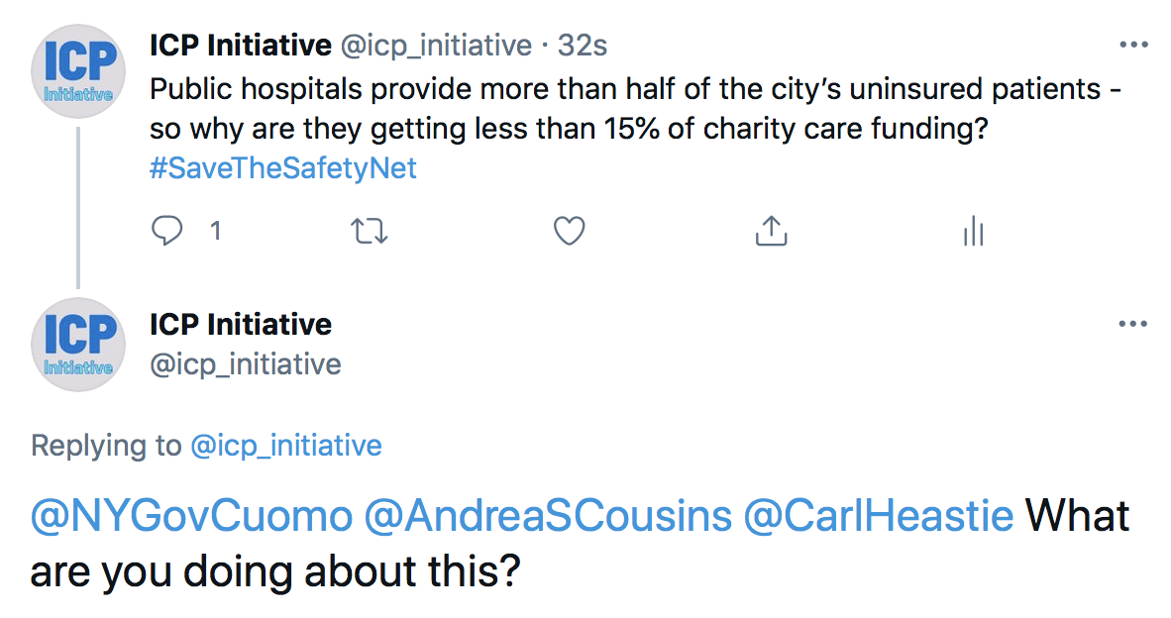
Example

Slide 6
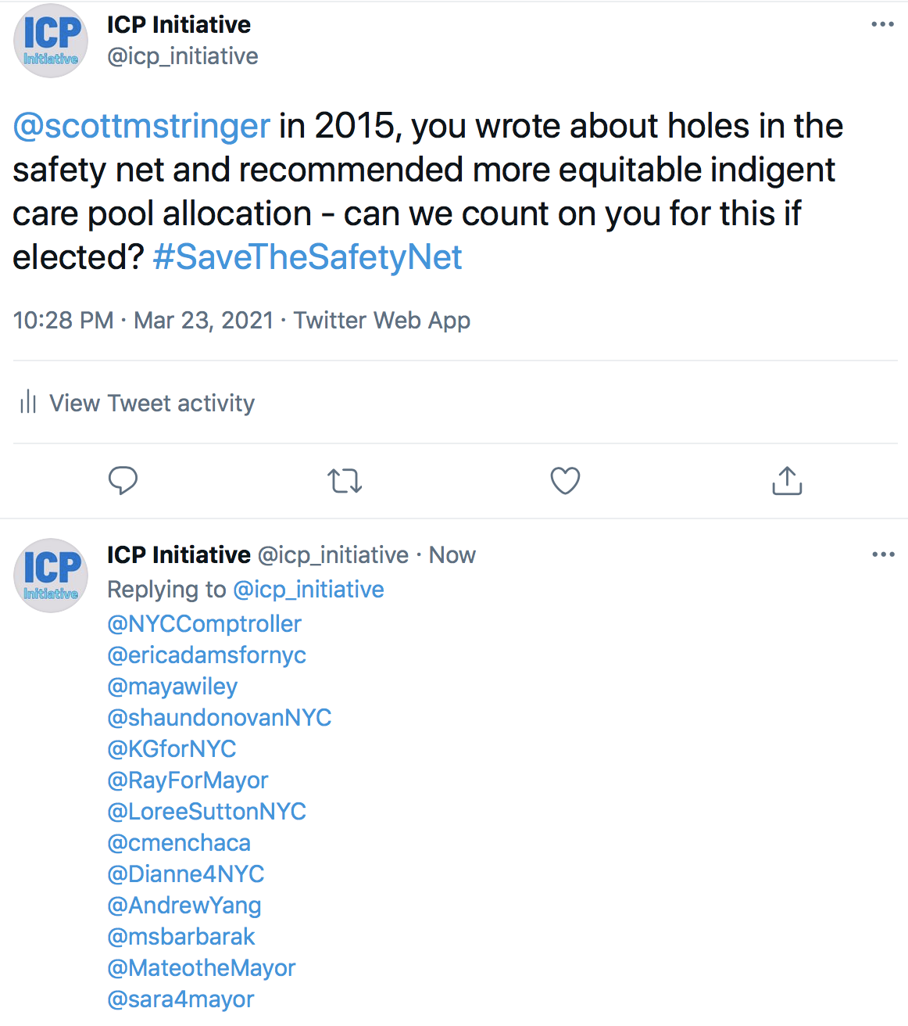
Example

Slide 7

Tag Supporters
@NYCHealthSystem
@MedicaidMtrsNY
@CPHSNYC
@NYHCampaign
@NYDocs
@bettykolod
@AndrewMakeTweet
@oni_blackstock

Slide 8
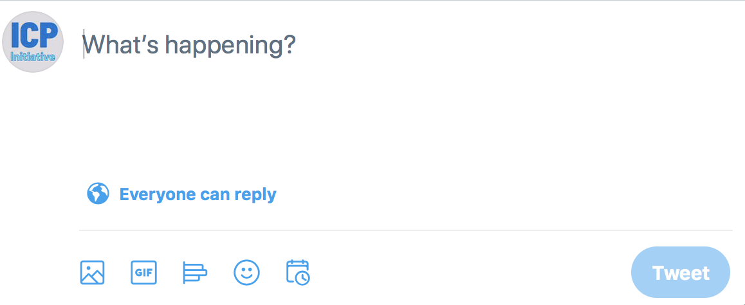
How to Schedule Your Tweet

Slide 9
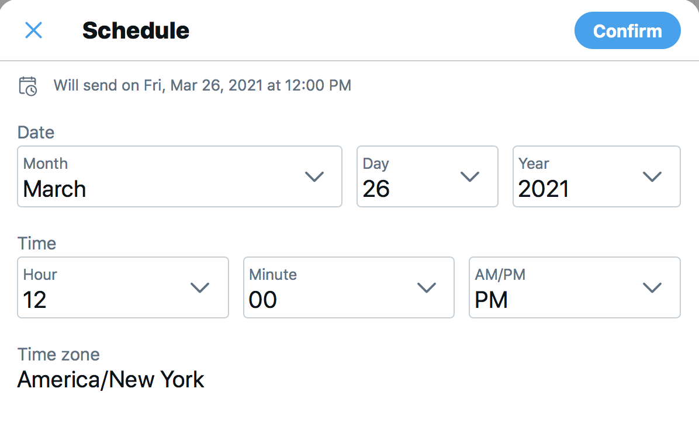
How to Schedule Your Tweet

Slide 10
Share With Your Friends!
Google Doc with Sample Tweets and Graphics
Slide Deck

